Slide 1


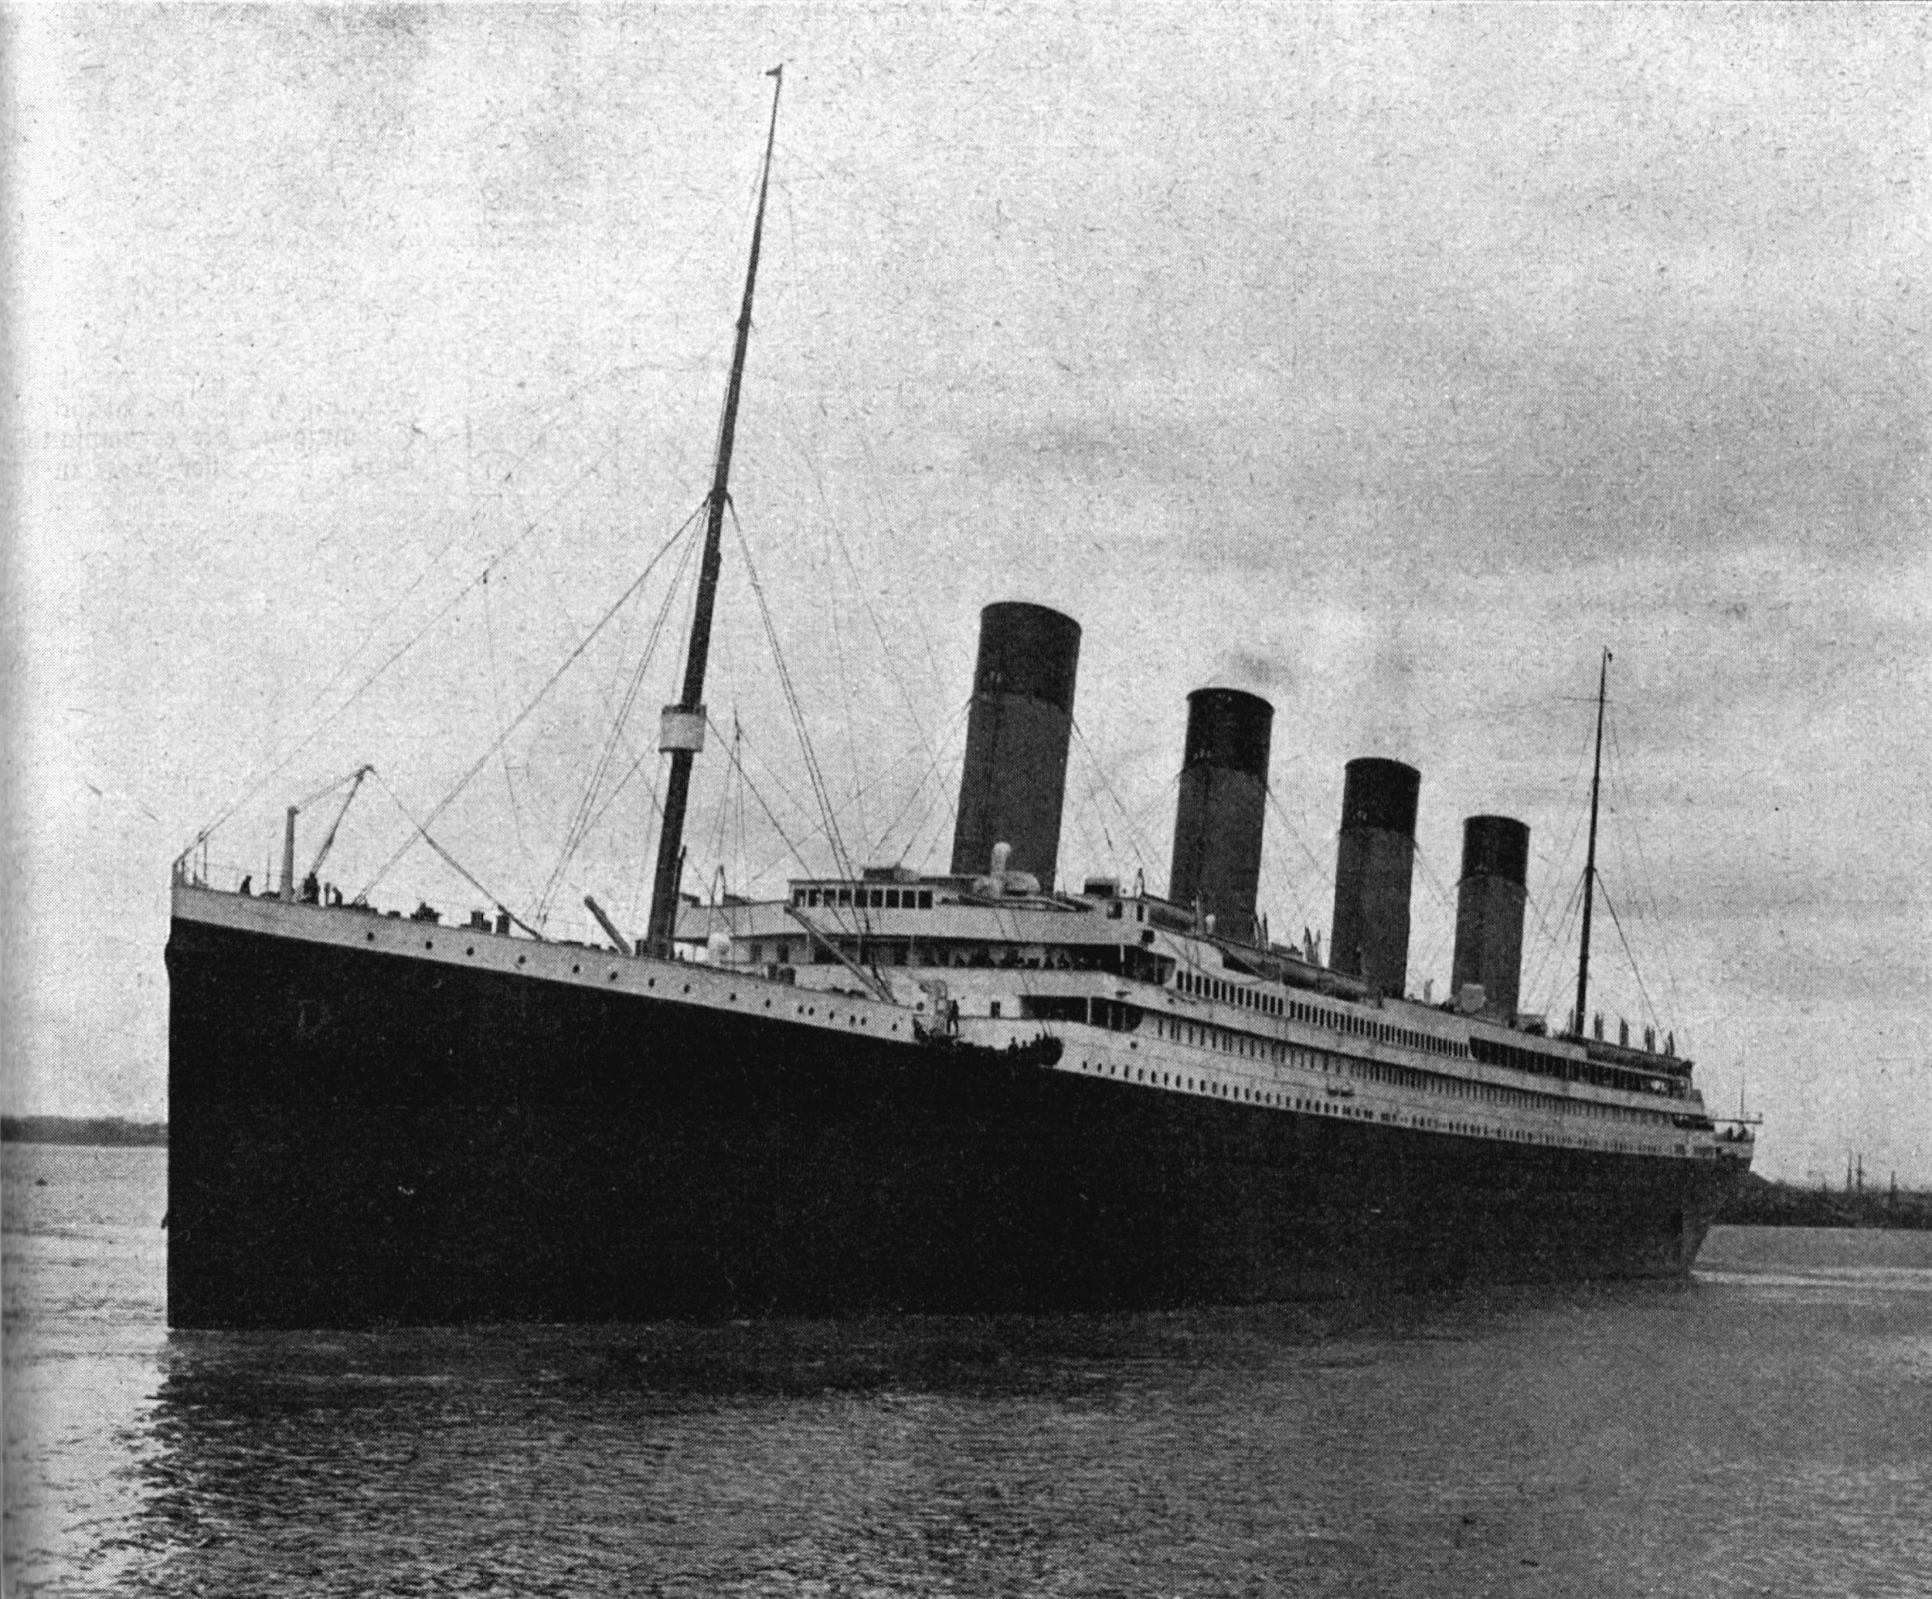
Titanic Project
Machine Learning Project
This Photo by Unknown Author is licensed under CC BY-SA
By :- Stephen, Justin, Armando, and Harjeet

Slide 2
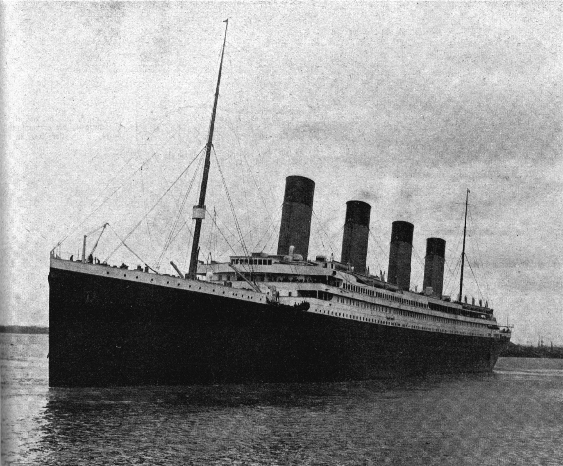
Introduction
The Titanic sank on its maiden voyage on April 15, 1912 after hitting an iceberg. Out of the 2224 passengers on board, 1502 died. The dataset that was analyzed in the following sections contains detailed information about 891 passengers data downloaded from Kaggle.

Slide 3

Titanic Disaster Observations
One reason that the wreck prompted such a high number of deaths was that there were insufficient rafts for passengers and crew.
The sinking made the interesting observation that some people were more likely to survive than others, like women, and children because they were rescued first.

Slide 4
Goals
Analyze the data for efficient prediction of survival
Utilize various machine learning algorithms to predict kinds of people who were most likely to survive.

Slide 5
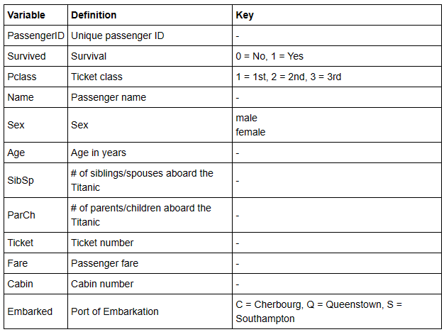
Feature Description of The Data
The data set has 12 columns as shown in the table with their details.

Slide 6
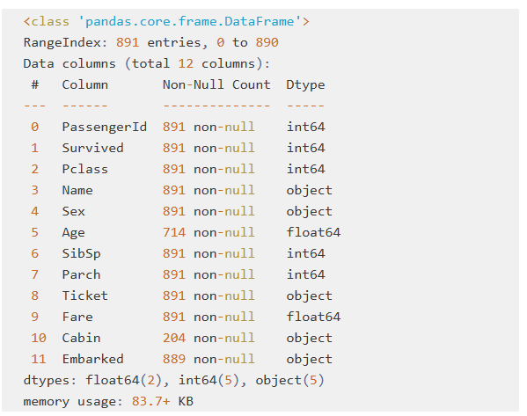
Information of the Data

Slide 7
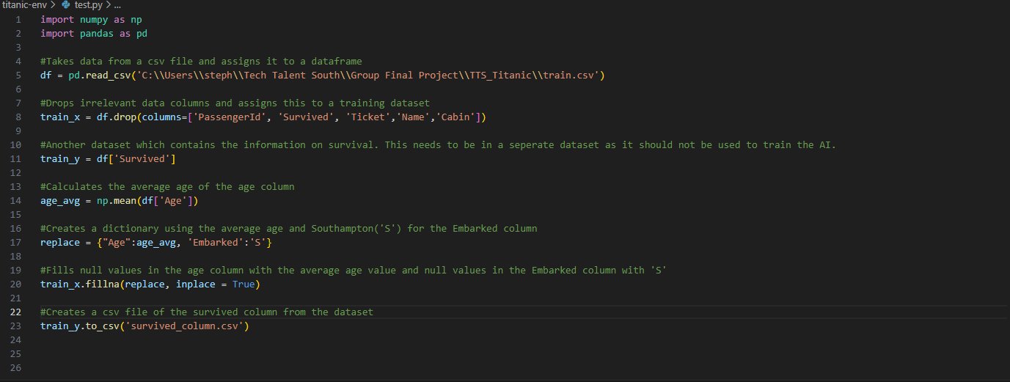
Data Cleansing

Slide 8
Data Information
For analysis, we dropped some columns such as
Passenger Id
Name
Cabin
Ticket
because data in these columns does not affect the prediction survival of passenger.

Slide 9

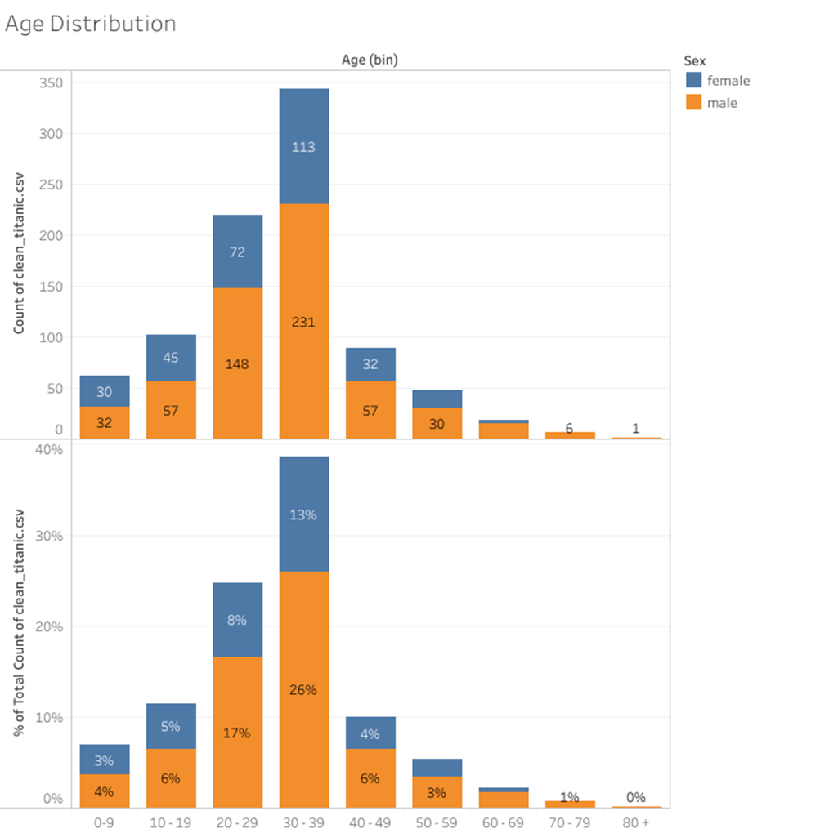
Age Distribution
We observed that the 30 -39 age group had a higher population count. This can be attributed to the fact that this age group was predominantly young and likely seeking better opportunities to improve their lives.
As a consequence, we can expect a significant number of passengers from this bin to have perished on the Titanic.
Notes:
For the bins, we grouped ages in increments of 10, such as 0, 10, 20, 30, and 80. All ages were assigned to their respective age bin. For example, if a passenger was 35 years old, they would fall into the 30 bin. We also divided the passengers into two sex groups: Female and Male.
Based on our analysis, we observed that the 30 bin had a higher population count. This can be attributed to the fact that this age group was predominantly young and likely seeking better opportunities to improve their lives. As a consequence, we can expect a significant number of passengers from this bin to have perished on the Titanic.
It is worth noting that while the 30 bin had a higher population, further analysis is needed to fully understand the impact of age and sex on survival rates. Other factors, such as socio-economic status and access to lifeboats, may have also played a significant role in determining survival outcomes.
By considering these additional factors, we can gain a more comprehensive understanding of the demographics and potential outcomes of the passengers aboard the Titanic.

Slide 10
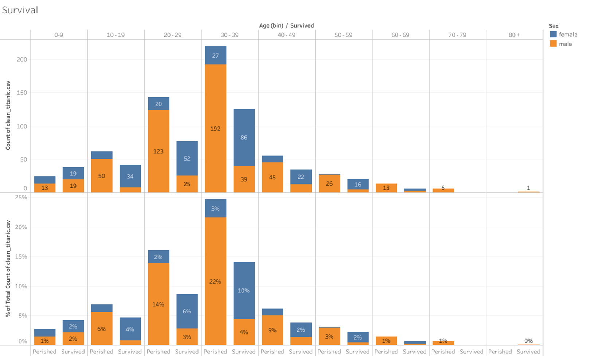
Survival by Sex and Age
In every age group there are two bars Perished and Survived.
Women and children had higher chances of survival across all age groups, supporting the "women and children first" protocol.
These findings emphasize the importance of age and gender in determining survival outcomes during the Titanic disaster.
Notes:
Age groups significantly influenced survival rates, with the 30 age bin being the most affected. The age distribution followed a bell-shaped curve, showing decreasing survival probabilities with increasing age. Women and children had higher chances of survival across all age groups, supporting the "women and children first" protocol. These findings emphasize the importance of age and gender in determining survival outcomes during the Titanic disaster. By further exploring the data and considering additional factors such as passenger class, socio-economic status, and cabin location, we can gain a more nuanced understanding of the complexities surrounding survival rates on the Titanic.

Slide 11

Survival Count
Total Females survived = 233
Total males survived = 107

Slide 12
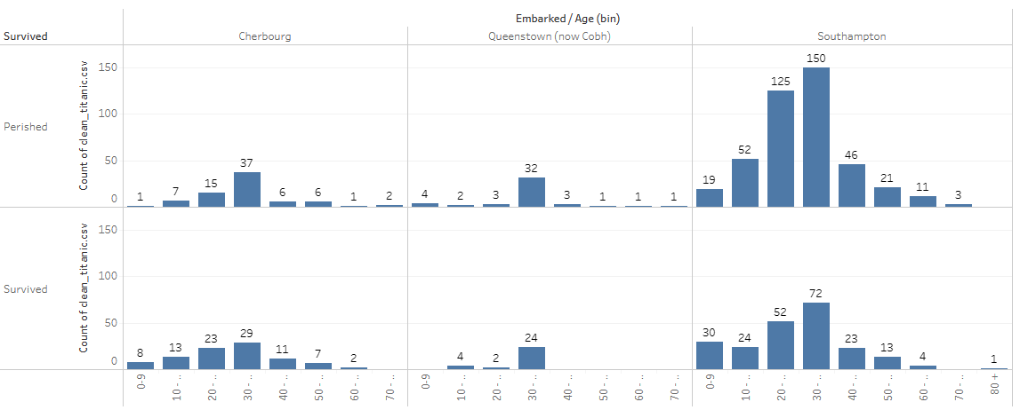
Departure Cities
Total Passenger Boarded
Southampton city= 646
Queenstown = 77
Cherbourg = 168
Total = 891
Data Indicates Survival
Southampton city= 219
Queenstown = 30
Cherbourg = 93
Total Survived = 342
Note: More than 70% of the people boarded from Southampton. Just under 20% boarded from Cherbourg and the rest boarded from Queenstown.
Notes:
The Titanic had three primary cities from which passengers embarked: Southampton, England; Cherbourg, France; and Queenstown (now Cobh), Ireland. These cities served as the starting points for the ill-fated voyage, with passengers boarding the ship before it set sail on its tragic journey across the Atlantic Ocean. There are three possible values for Embark — Southampton, Cherbourg, and Queenstown. More than 70% of the people boarded from Southampton. Just under 20% boarded from Cherbourg and the rest boarded from Queenstown.

Slide 13
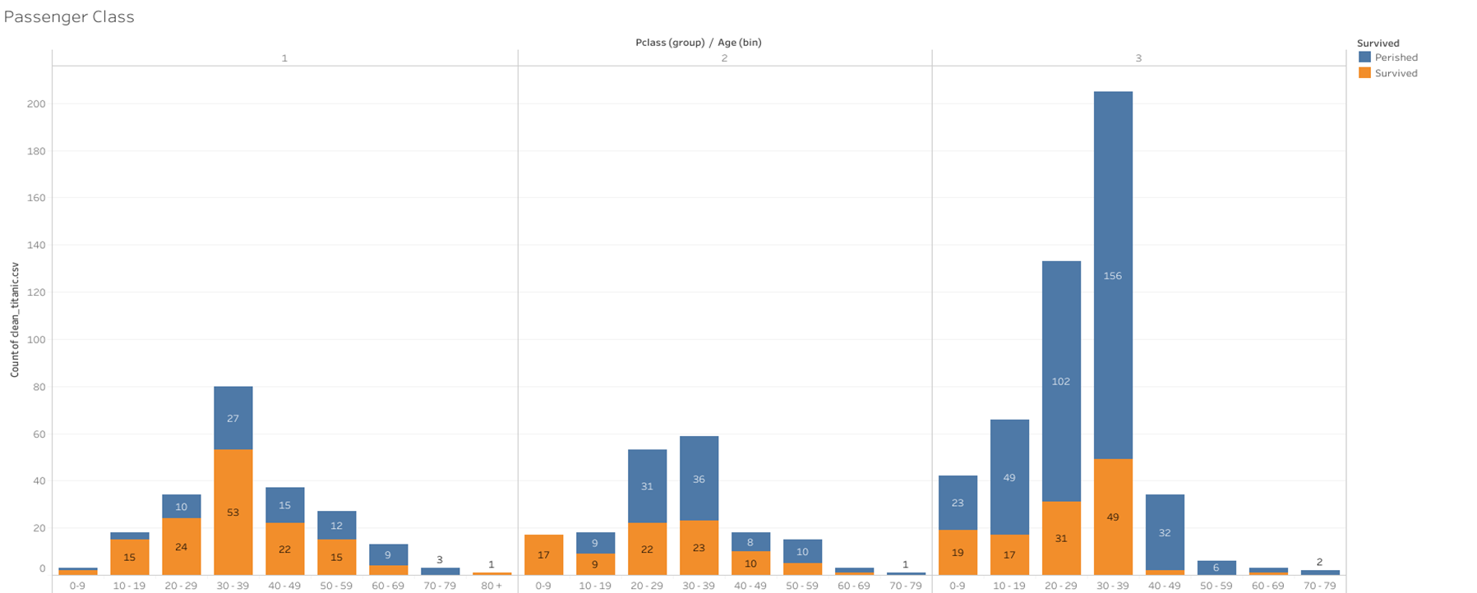
PClass( Ticket Fare)
First Class passengers had the highest survival rate, benefiting from their privileged access to lifeboats and familiarity with the ship.
Notes:
Passenger class played a significant role in the survival outcome on the Titanic. First Class passengers had the highest survival rate, benefiting from their privileged access to lifeboats and familiarity with the ship. Second Class passengers fared better than Third Class but still had a lower survival rate. Third Class passengers, particularly those in lower sections of the ship, faced greater challenges and had the lowest survival rate. This analysis highlights the unequal distribution of resources and social dynamics that impacted survival during the tragic event.

Slide 14
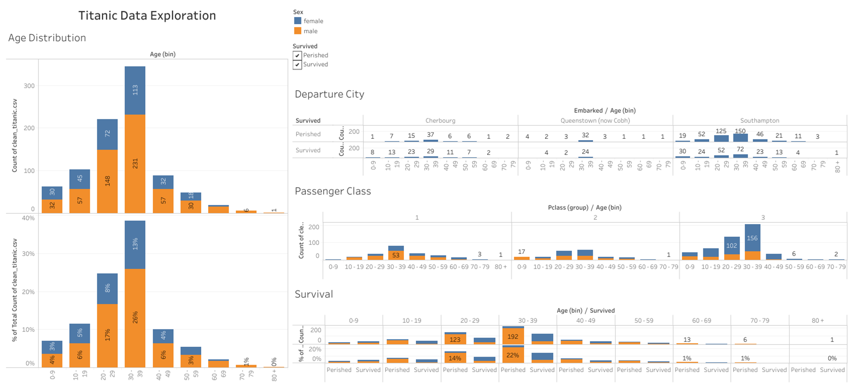
Tableau Dashboard

Slide 15
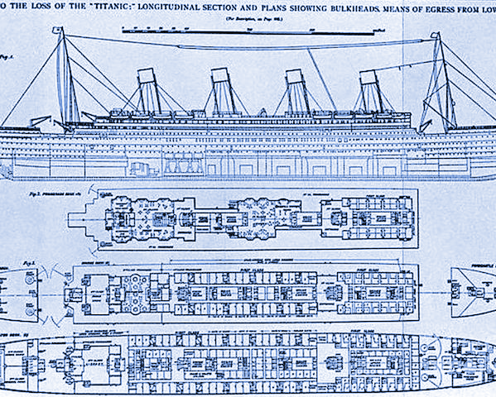
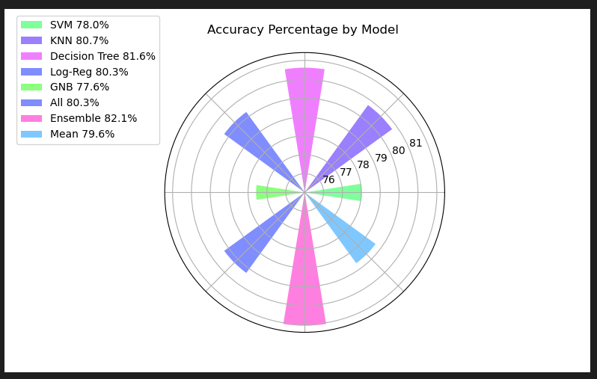
Machine Learning Algorithms

Slide 16
Decision Tree had the highest rate of success as a standalone algorithm with 81.6%
Support Vector Machine (78.0%) and Gaussian Naive Bias (77.6%) came in last and were dropped for the final ensemble
The individual algorithm averaged 79.6%
The ensemble with all individual algorithms did not perform well similar in score to Logistic Regression (80.3%)
The ensemble with SVM, KNN, and Decision Tree performed overall the best at 82.1%
Note: Parameters were not tuned.

Slide 17
Continuing…
Hyperparameter tuning
Feature reduction and engineering
Research and impute other columns
Enter kaggle competition

Slide 18
Conclusions
Sex - Females are more likely to survive because they were given preference over the other passengers
Pclass - Those who paid the higher fare are more likely to survive due to easy access to boats.
Embarked – Those who embarked at Southampton have a higher chance of survival.
Age – People in age group of 30-39 have higher chances of survival.

Slide 19
References
https://github.com/Riversjp7/TTS_Titanic
https://public.tableau.com/app/profile/armando.maluana2021

